Slide 1
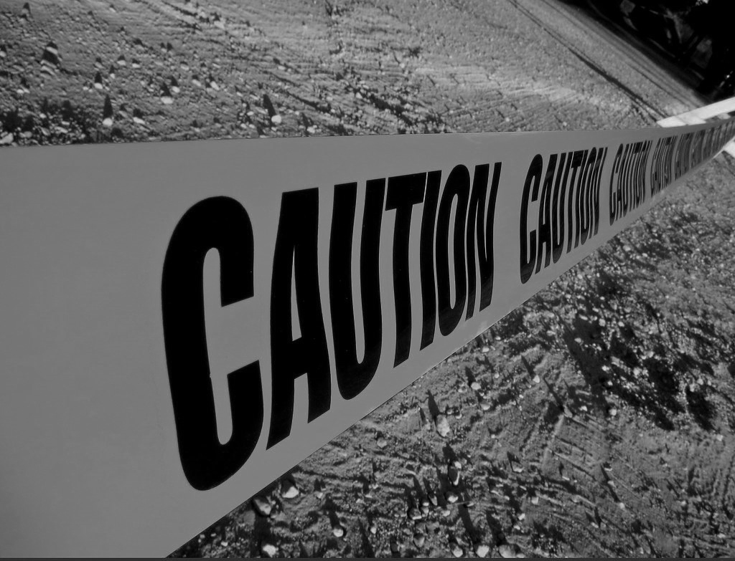
Hazards and risks
Akbar Qamar
Mechatronics Engineering
2nd Week of Teaching
This Photo by Unknown Author is licensed under CC BY-NC-ND
Notes:
1

Slide 2
Identifying, Assessing, and Mitigating Risks in Mechatronic Systems
How to Stay Safe
Akbar Qamar
Mechatronics
2
Notes:
2

Slide 3

What is a hazard?
What is it Not?
Akbar Qamar
Mechatronics
3
Notes:
3

Slide 4
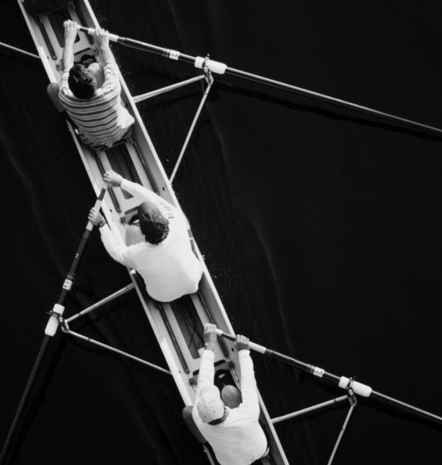
Defining the Concept of a Hazard
A hazard is an event, situation, condition, or object that has the potential to cause harm, injury, or damage.
Akbar Qamar
Mechatronics
4
Notes:
4

Slide 5
Key Characteristics:
Potential for Harm:
Unpredictability:
The hazard must have the ability to cause physical harm, financial loss, or other negative consequences.
Hazards can be either predictable (e.g., a loose wire) or unpredictable (e.g., an earthquake).
Akbar Qamar
Mechatronics
5
Notes:
5

Slide 6
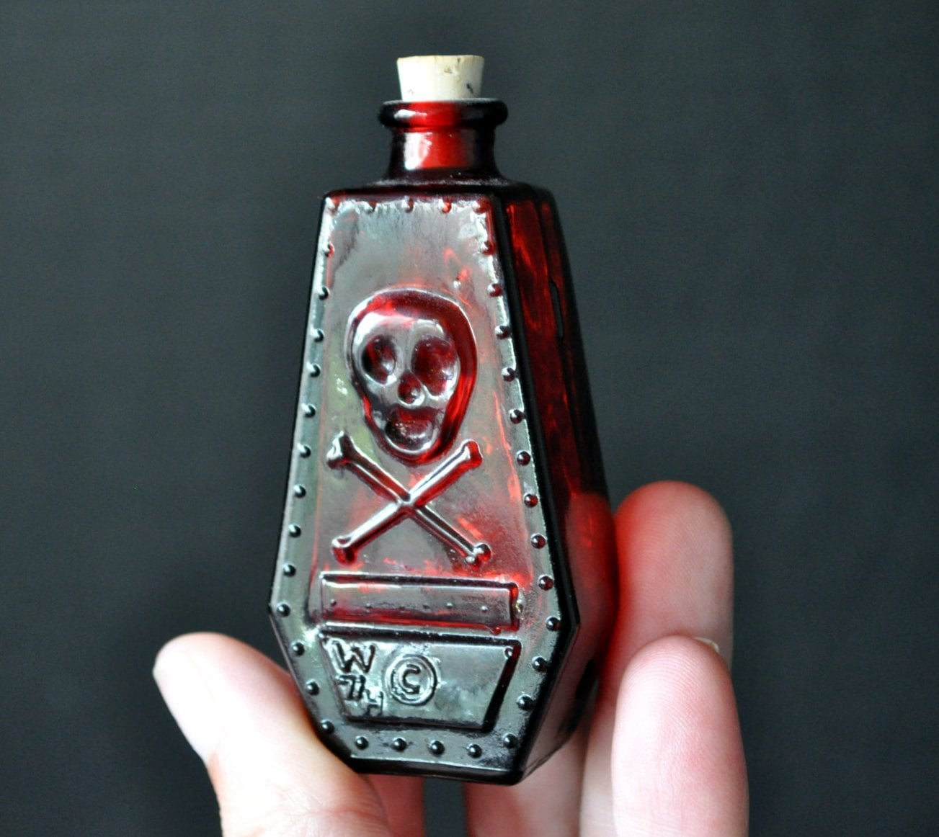
Types of Hazards:
Physical hazards:
  Chemicals
  Biological agents
  Mechanical objects
Environmental hazards:
  Weather-related events
  Natural disasters
Human-made hazards:
  Equipment malfunctions
  Poor design or maintenance
Akbar Qamar
Mechatronics
6

Slide 7

What is the hazard?
Akbar Qamar
Mechatronics
7

Slide 8
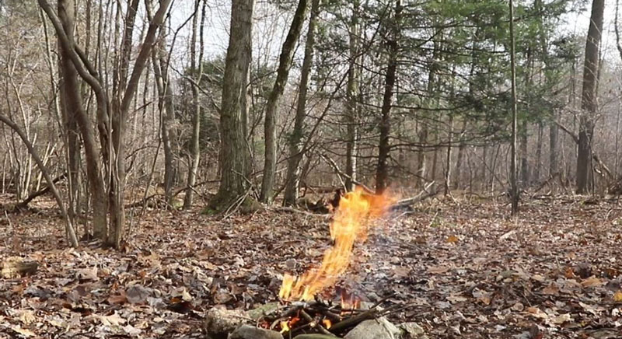
What is the hazard?
Akbar Qamar
Mechatronics
8

Slide 9
Examples of
Hazards:
A slippery floor in a workplace due to spilled oil.
A faulty electrical wire that can cause an electric shock.
A wildfire spreading rapidly through dry vegetation.
Akbar Qamar
Mechatronics
9

Slide 10

Importance: Identifying and mitigating hazards is crucial for preventing accidents, injuries, and fatalities.
Akbar Qamar
Mechatronics
10

Slide 11

What is a risk?
What is it Not?
Akbar Qamar
Mechatronics
11
Notes:
11

Slide 12

Defining the Concept of a risk
Risk is the likelihood and potential impact of an event or situation that could cause harm, injury, or damage.
Akbar Qamar
Mechatronics
12
Notes:
12

Slide 13
Key Components:
• Likelihood: The probability or chance of an event occurring.
Impact: The severity or magnitude of the consequences if the event occurs.
Consequences: The outcome or result of a hazardous event.
Akbar Qamar
Mechatronics
13

Slide 14
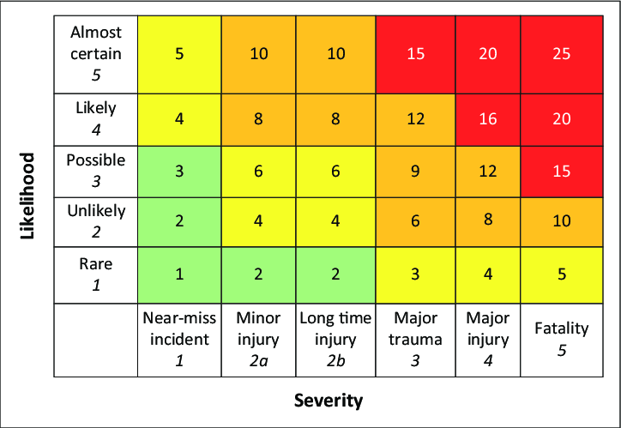
Assessment Matrix
Akbar Qamar
Mechatronics
14

Slide 15
Types of RISKS
Physical risks: Injuries or fatalities due to accidents, diseases, etc.
Akbar Qamar
Mechatronics
15
Notes:
15

Slide 16

Akbar Qamar
Mechatronics

Slide 17
Types of RISKS
Physical risks: Injuries or fatalities due to accidents, diseases, etc.
Financial risks: Economic losses due to damage, theft, or other financial consequences.
Akbar Qamar
Mechatronics
17
Notes:
17

Slide 18

Akbar Qamar
Mechatronics

Slide 19
Types of RISKS
Physical risks: Injuries or fatalities due to accidents, diseases, etc.
Financial risks: Economic losses due to damage, theft, or other financial consequences.
Reputation risks: Damage to an organization's image or brand.
Akbar Qamar
Mechatronics
19
Notes:
19

Slide 20

Akbar Qamar
Mechatronics

Slide 21
examples of Risk:
A person driving a car at high speed on a wet road
  (high likelihood, low impact).
Akbar Qamar
Mechatronics
21
Notes:
21

Slide 22
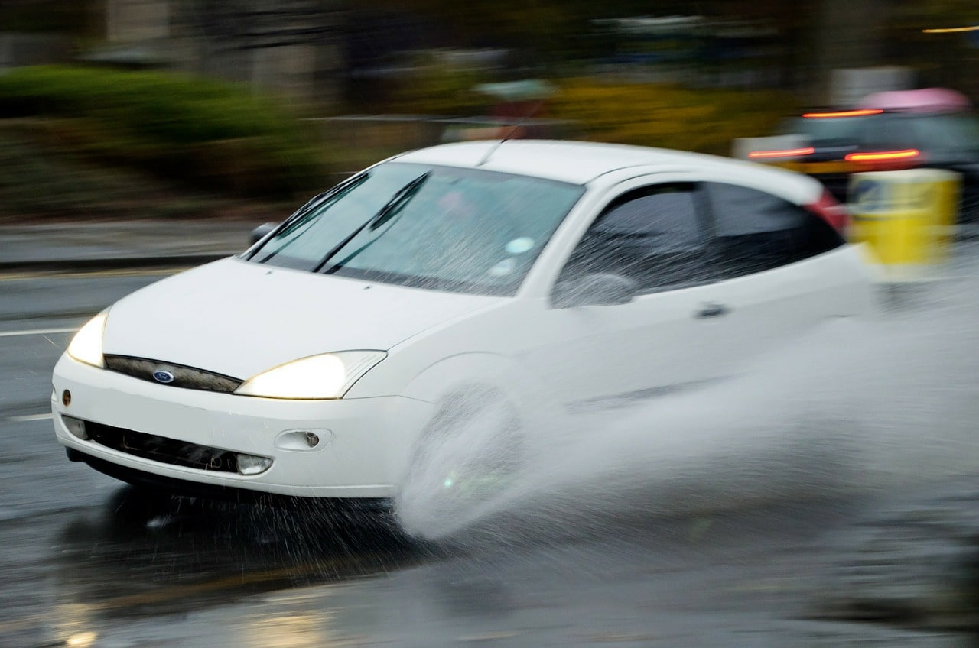
Akbar Qamar
Mechatronics

Slide 23
examples of Risk:
A person driving a car at high speed on a wet road
  (high likelihood, low impact).
A chemical spill in a factory
  (low likelihood, high impact).
Akbar Qamar
Mechatronics
23
Notes:
23

Slide 24
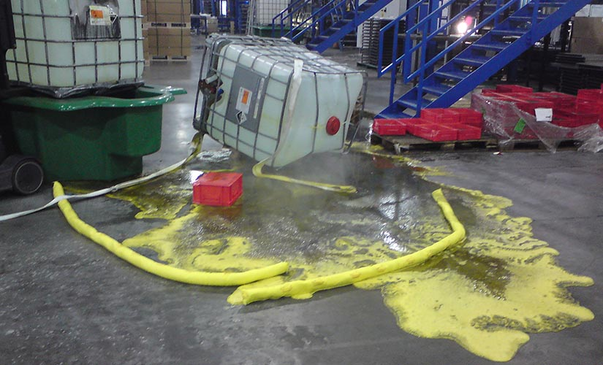
Akbar Qamar
Mechatronics

Slide 25

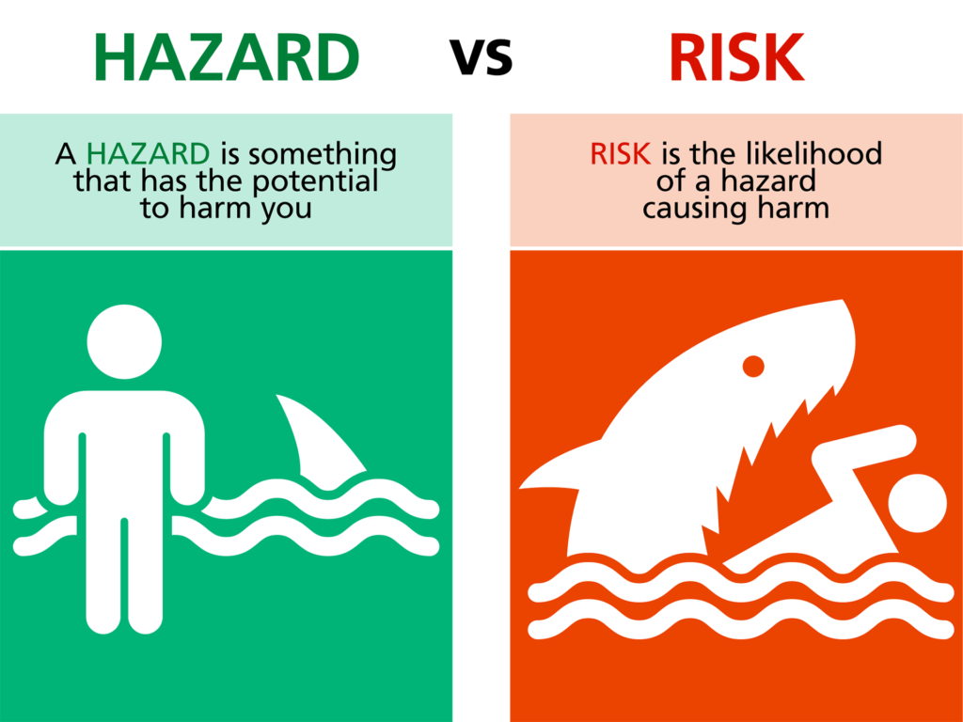
Akbar Qamar
Mechatronics
25
Notes:
25

Slide 26
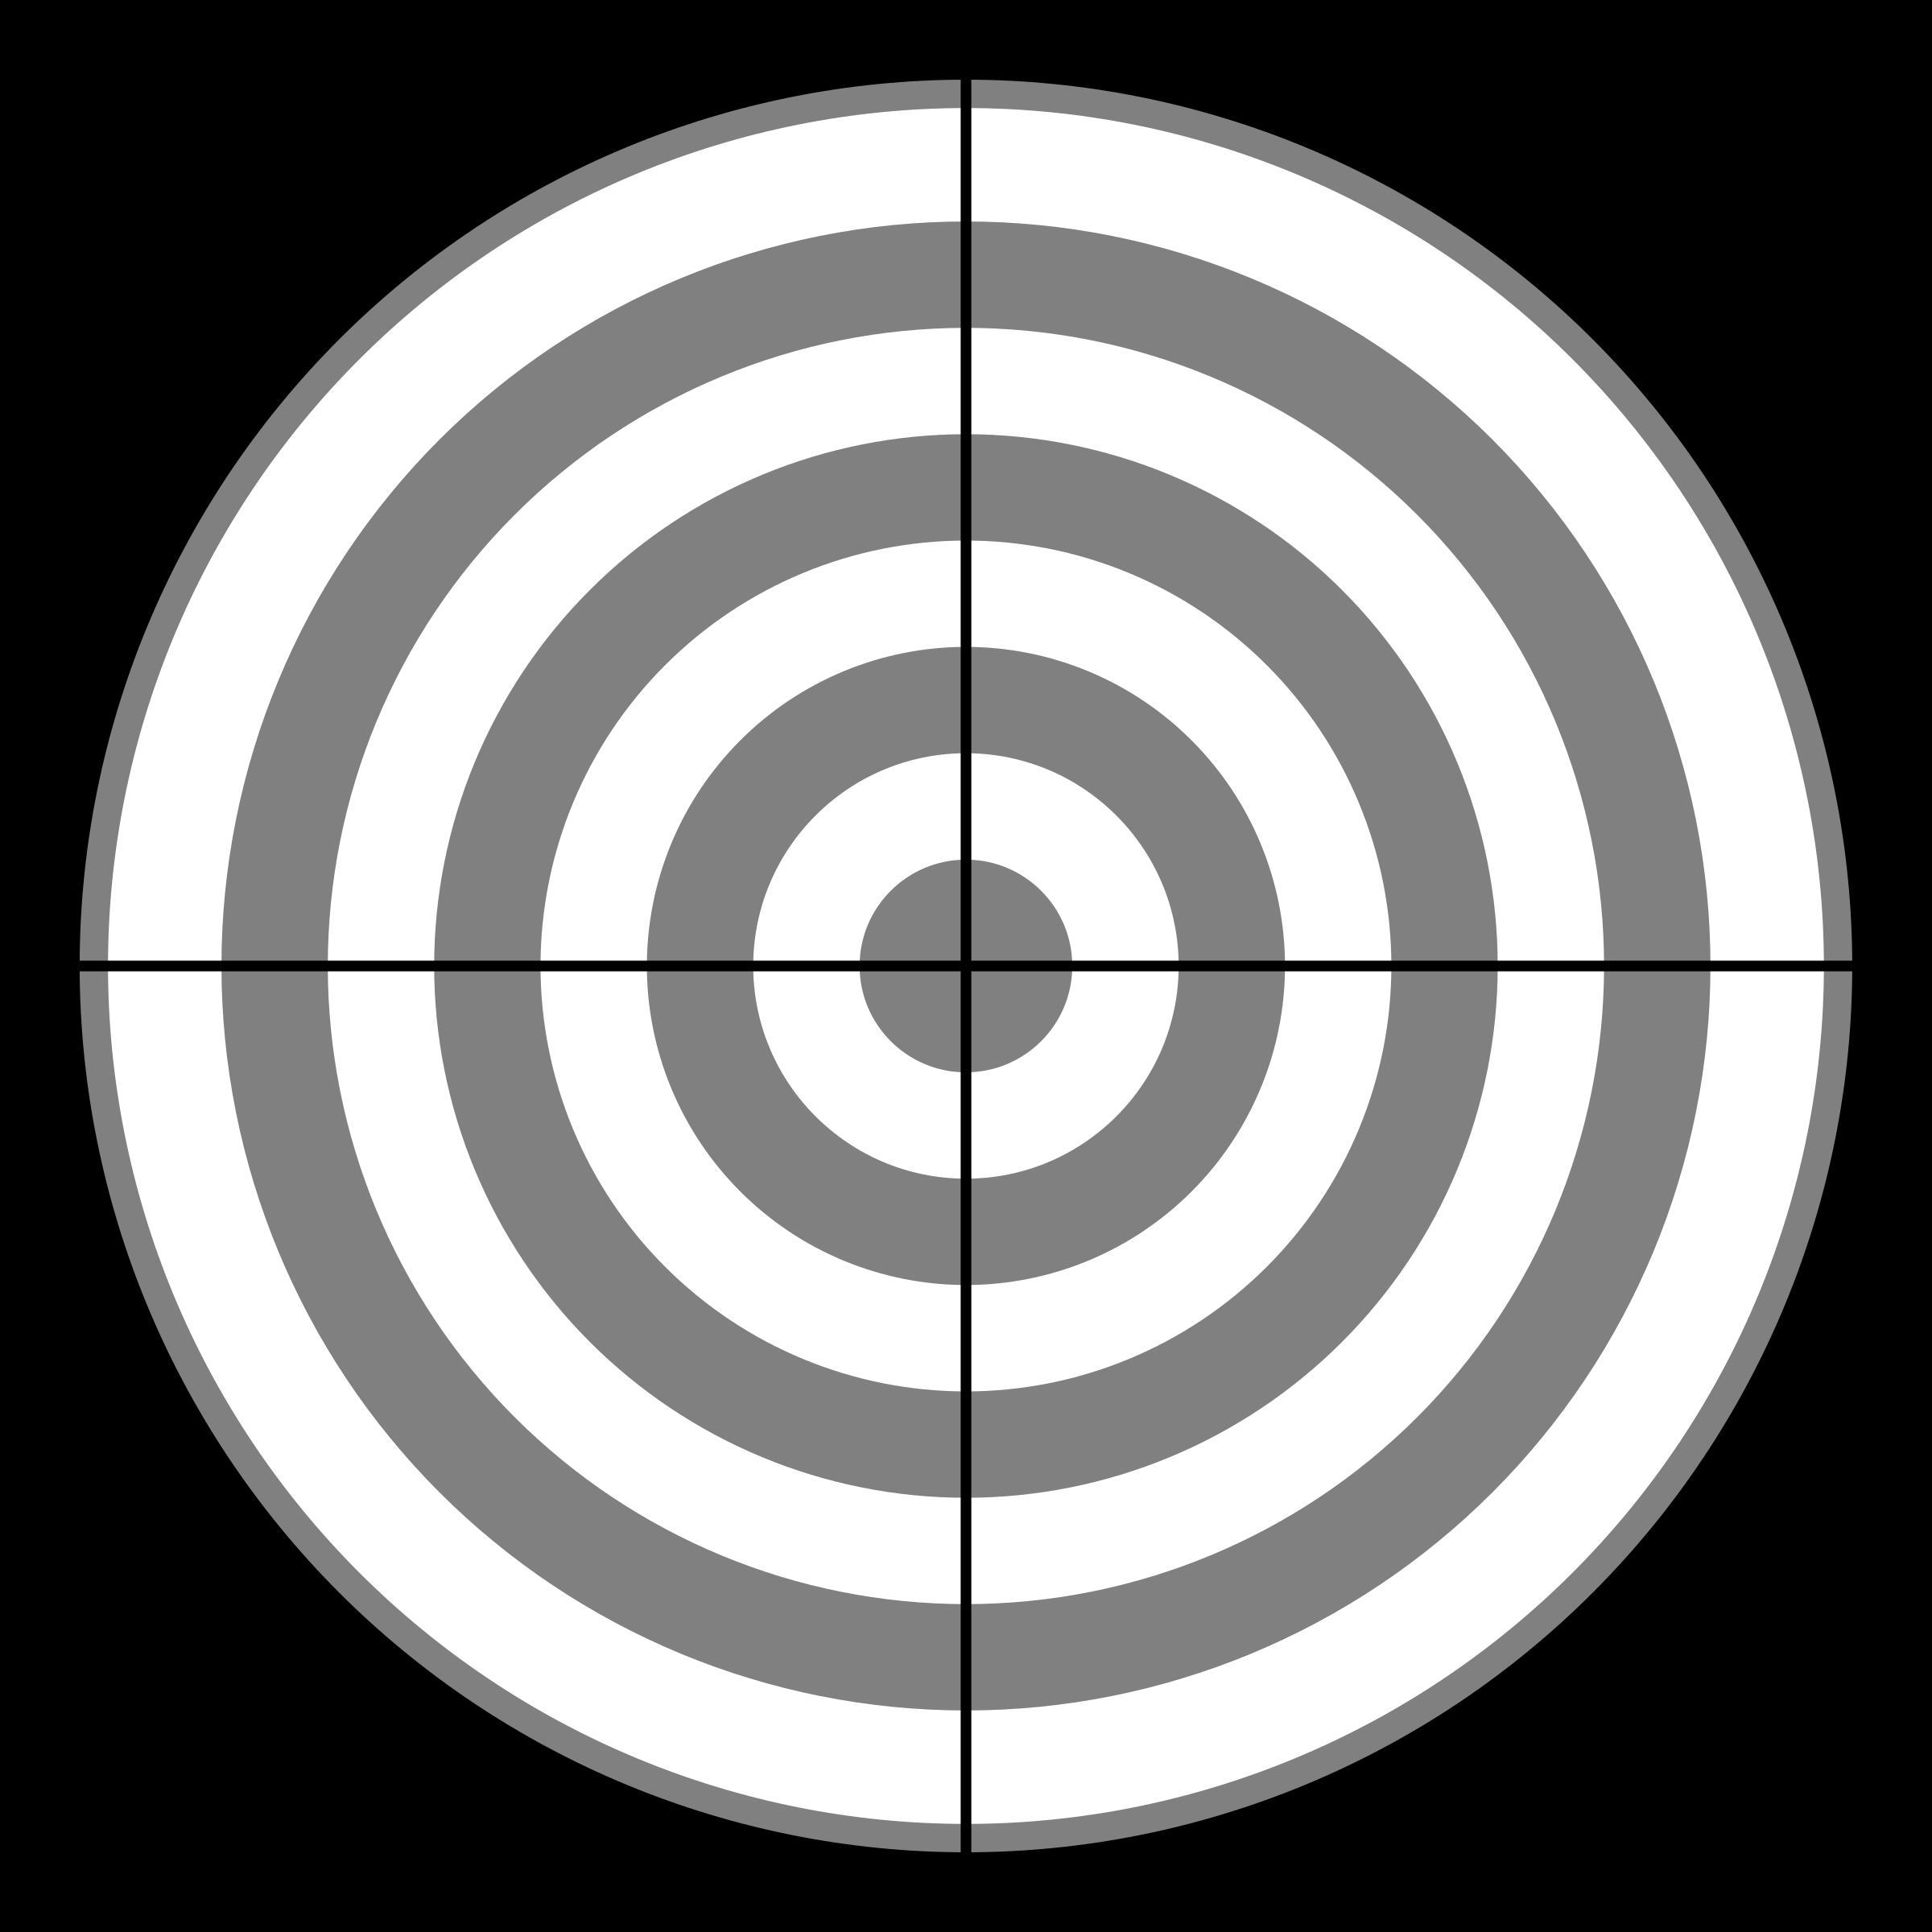
Image SLide
Identify 5 Hazards and The Risk Associated to it
Akbar Qamar
Mechatronics
26
Notes:
26

Slide 27

Akbar Qamar
Mechatronics

Slide 28
Hazard Identification Techniques
1. Workshop Inspections: Physically inspecting the system for potential hazards.
Akbar Qamar
Mechatronics
28
Notes:
28

Slide 29

Akbar Qamar
Mechatronics

Slide 30
Hazard Identification Techniques
1. Workshop Inspections: Physically inspecting the system for potential hazards.
2. Checklists: Using predefined lists to ensure all hazards are considered.
Akbar Qamar
Mechatronics
30
Notes:
30

Slide 31

Akbar Qamar
Mechatronics

Slide 32
Hazard Identification Techniques
1. Workshop Inspections: Physically inspecting the system for potential hazards.
2. Checklists: Using predefined lists to ensure all hazards are considered.
3. Brainstorming Sessions: Collaborating with a team to identify hazards.
Akbar Qamar
Mechatronics
32
Notes:
32

Slide 33
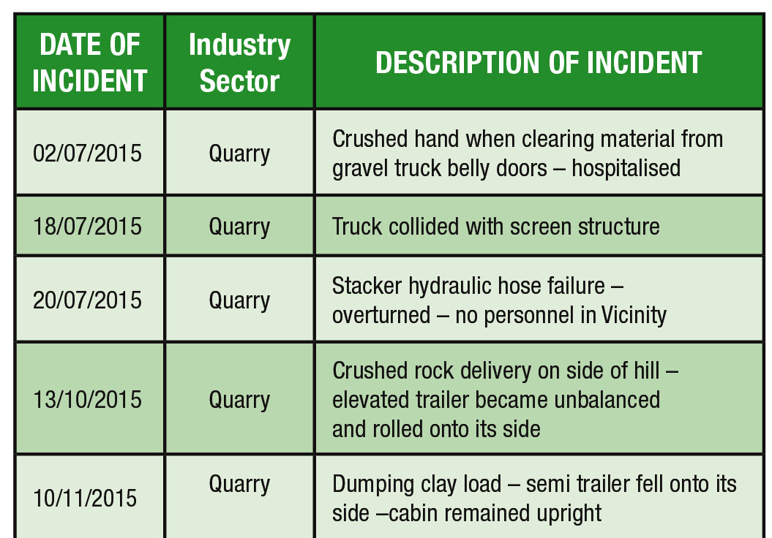
Akbar Qamar
Mechatronics

Slide 34
Hazard Identification Techniques
1. Workshop Inspections: Physically inspecting the system for potential hazards.
2. Checklists: Using predefined lists to ensure all hazards are considered.
3. Brainstorming Sessions: Collaborating with a team to identify hazards.
4. Historical Data Analysis: Reviewing past incidents or near-misses.
Akbar Qamar
Mechatronics
34
Notes:
34

Slide 35

Akbar Qamar
Mechatronics
35

Slide 36
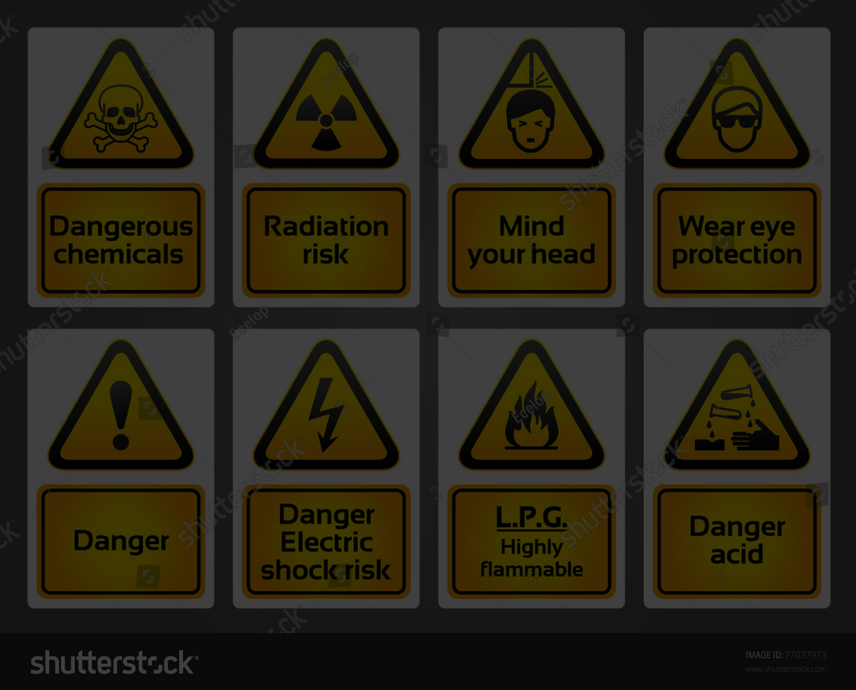
Mitigation Strategies
Pro-Active
Akbar Qamar
Mechatronics
36
Notes:
36

Slide 37

The Cycle
Identify
Prioritize
Mitigate
Akbar Qamar
Mechatronics
37
Notes:
37

Slide 38
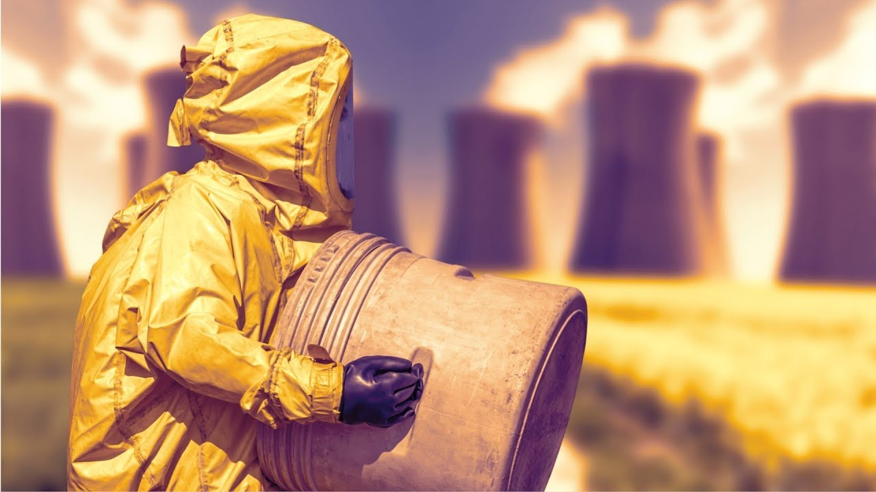
Akbar Qamar
Mechatronics
38

Slide 39
Mitigation Techniques
Elimination: Remove the hazard entirely (e.g., redesigning a system).
Akbar Qamar
Mechatronics
39
Notes:
39

Slide 40

Akbar Qamar
Mechatronics
40

Slide 41
Mitigation Techniques
Elimination: Remove the hazard entirely (e.g., redesigning a system).
Substitution: Replace hazardous components with safer alternatives.
Akbar Qamar
Mechatronics
41
Notes:
41

Slide 42
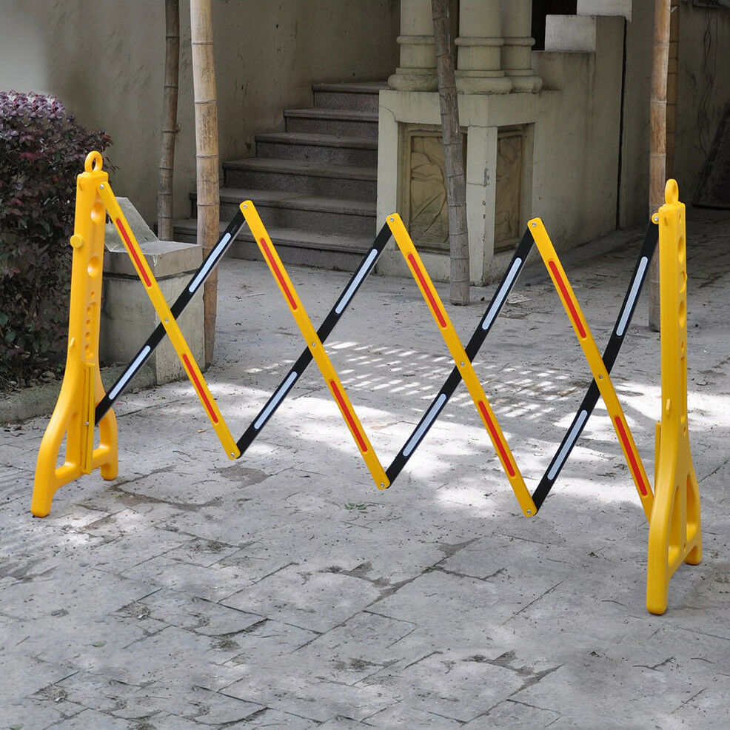
Akbar Qamar
Mechatronics
42

Slide 43
Mitigation Techniques
Elimination: Remove the hazard entirely (e.g., redesigning a system).
Substitution: Replace hazardous components with safer alternatives.
Engineering Controls: Add physical safeguards (e.g., barriers, sensors).
Akbar Qamar
Mechatronics
43
Notes:
43

Slide 44

Akbar Qamar
Mechatronics
44

Slide 45
Mitigation Techniques
Elimination: Remove the hazard entirely (e.g., redesigning a system).
Substitution: Replace hazardous components with safer alternatives.
Engineering Controls: Add physical safeguards (e.g., barriers, sensors).
Administrative Controls: Implement safety protocols and training.
Akbar Qamar
Mechatronics
45
Notes:
45

Slide 46
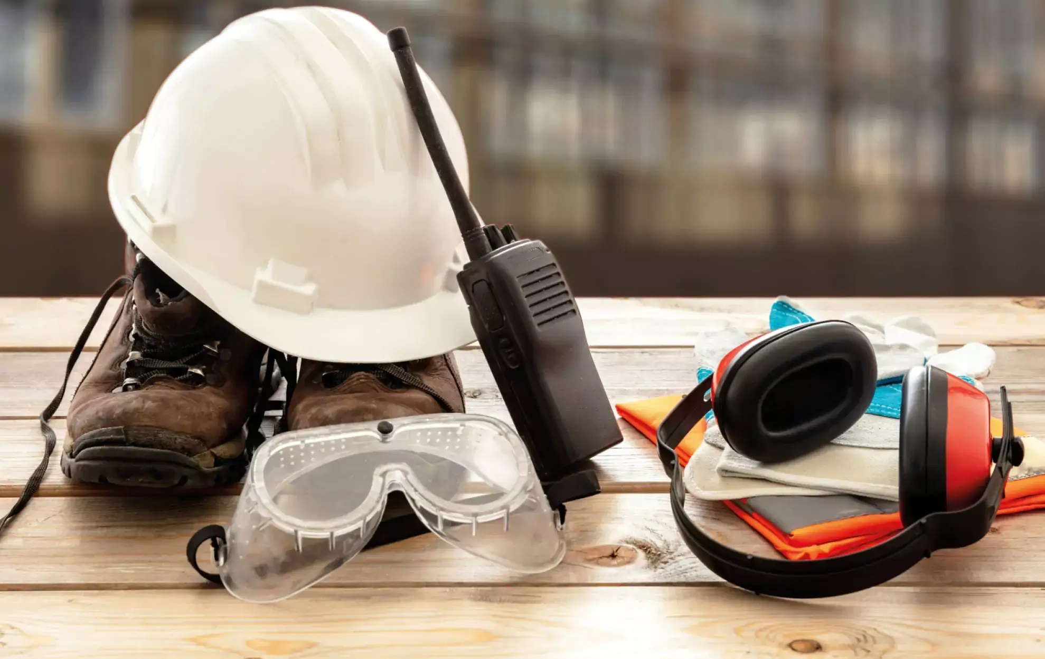
Akbar Qamar
Mechatronics
46

Slide 47
Mitigation Techniques
Elimination: Remove the hazard entirely (e.g., redesigning a system).
Substitution: Replace hazardous components with safer alternatives.
Engineering Controls: Add physical safeguards (e.g., barriers, sensors).
Administrative Controls: Implement safety protocols and training.
Personal Protective Equipment (PPE): Use gloves, goggles, etc., as a last line of defense.
Akbar Qamar
Mechatronics
47
Notes:
47

Slide 48
THANK YOU
Akbar Qamar
Mechatronics
WOODGROVE BANK
Notes:
48

